Slide 1
Lab # 3 (Week # 5)
Practice #1 OpenMP programming
Scheduling Clause: Static vs Dynamic and Chunk size
Parallelizing parallel loops using collapse ()
OpenMP API calls
#pragma omp Atomic
Reduction clause reduction (+:sum)

Slide 2
Practice – OpenMP Coding Problem
Show OpenMP C code snippet where 8 threads work together to computer sum of an 800K array of integers.
Use any one thread to initialize the array.
All threads will takes part in the summing computations.
Sum in a global variable in the main () functions.
Use OpenMP constructs used in Lab # 1 and Lab # 2 only.

Slide 3
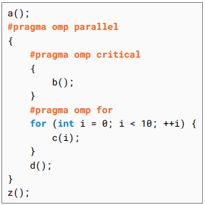
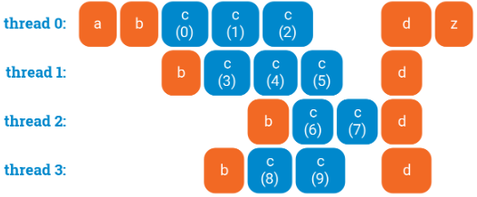

Slide 4
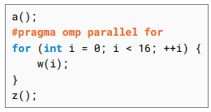
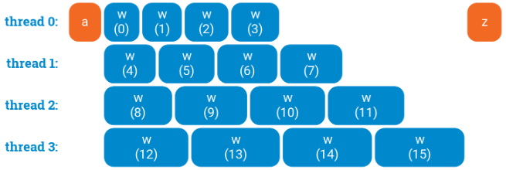
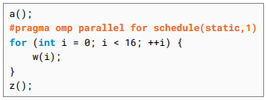
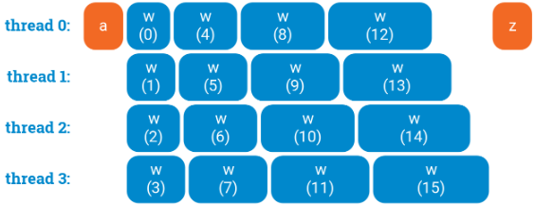

Slide 5
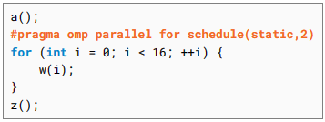
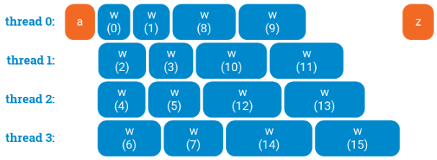

Slide 6
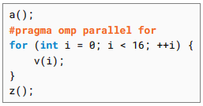
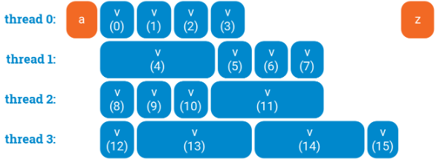

Slide 7
In dynamic scheduling:
each thread will take one iteration,
process it, and
then see what is the next iteration that is currently not being processed by anyone.
Dynamic scheduling is expensive: there is some communication between the threads after each iteration of the loop. Increasing the chunk size may help here to find a better trade-off between balanced workload and coordination overhead.
Dynamic scheduling does not necessarily give an optimal schedule. OpenMP cannot predict the future; it is just assigning loop iterations to threads in a greedy manner.

Slide 8
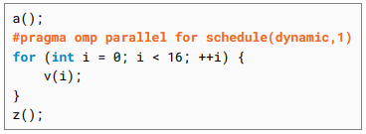
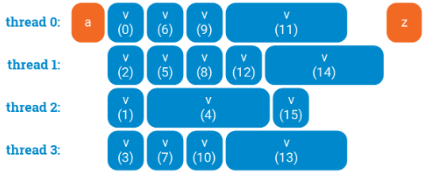

Slide 9
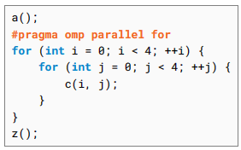
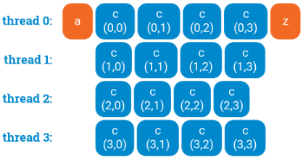
- It is often enough to simply parallelize the outermost loop

Slide 10
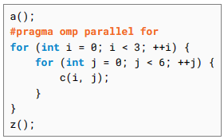
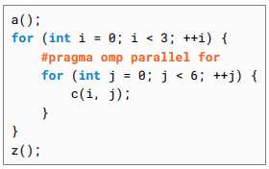
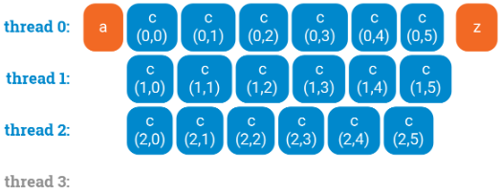
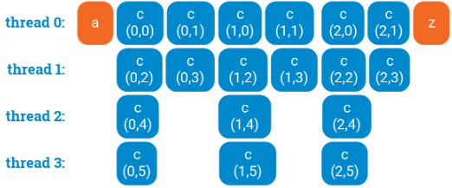

Slide 11

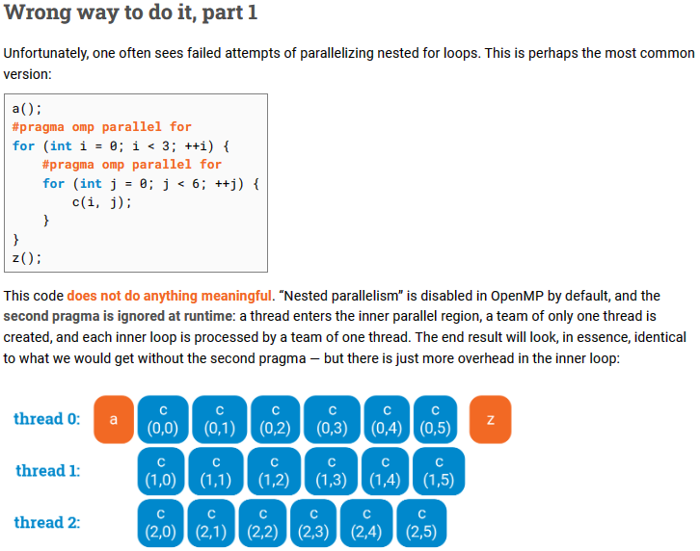

Slide 12
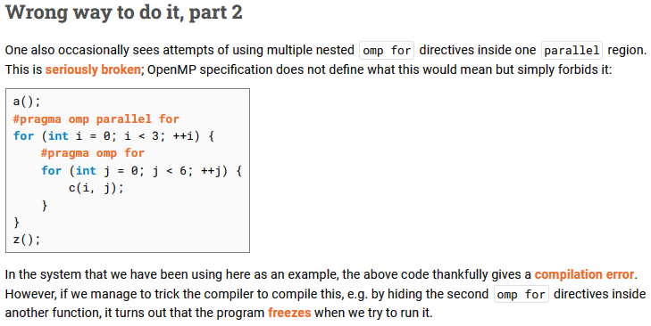

Slide 13
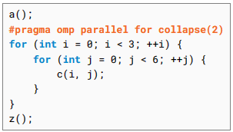
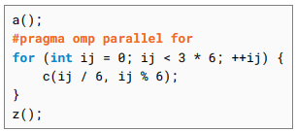
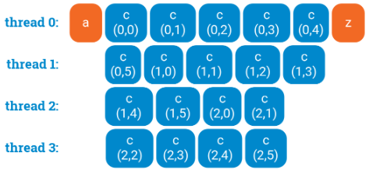

Slide 14
To measure the wall clock time each thread took to process the workload
omp_get_thread_num():
A function to get the unique thread ID of the calling thread.
2. omp_get_num_threads():
A function to get the total number of threads in the current parallel region.
3. omp_get_wtime():
A function to measure wall-clock time, useful for timing parallel sections of code.
4. omp_set_num_threads():
Sets the number of threads for a parallel region programmatically.
#include <omp.h>
…
double start_time = omp_get_wtime();
#pragma omp parallel num_threads(NUM_THREADS)
{
….
double thread_start_time = omp_get_wtime();
// do work
double thread_end_time = omp_get_wtime();
…
}
double end_time = omp_get_wtime();
…

Slide 15
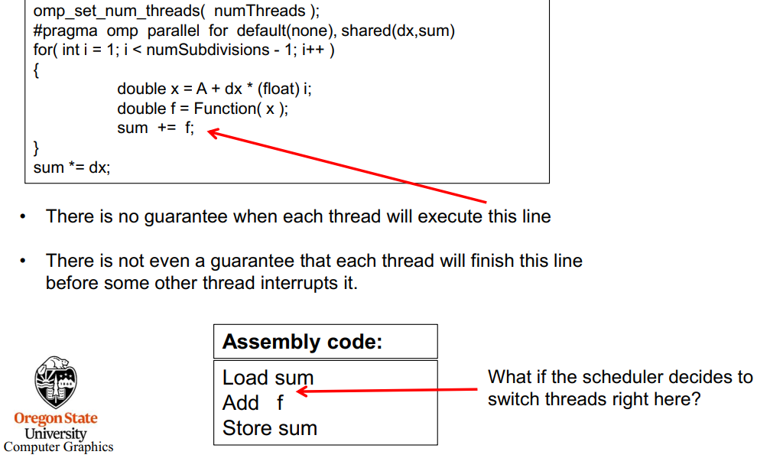
OpenMP Reduction Case Study: Trapezoid Integration Example (1)

Slide 16
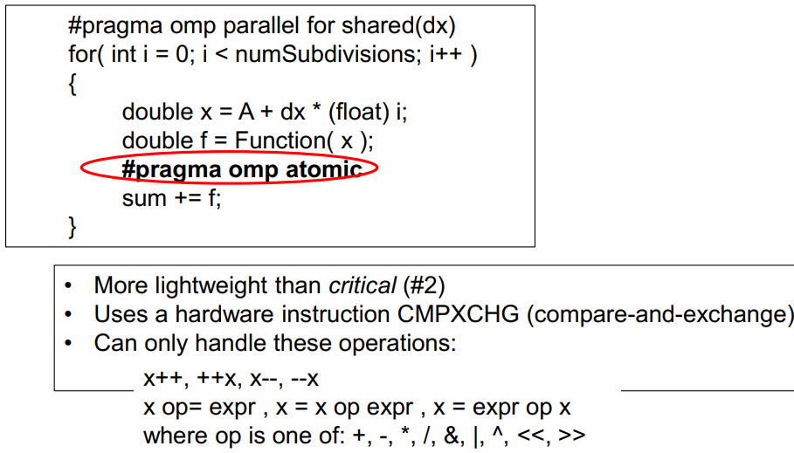
Three ways to solve this problem: (1 -> use Atomic)

Slide 17
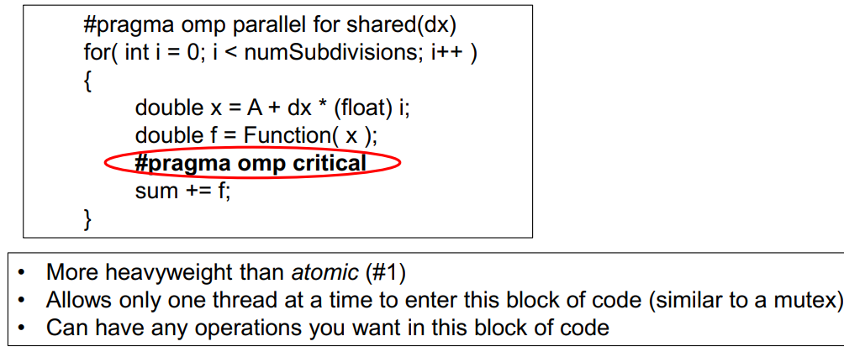
Three ways to solve this problem: (2 -> use Critical)

Slide 18
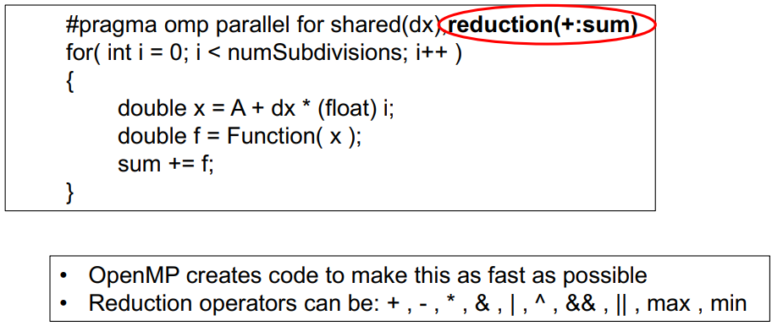
Three ways to solve this problem: (3 -> use Reduction)

Slide 19
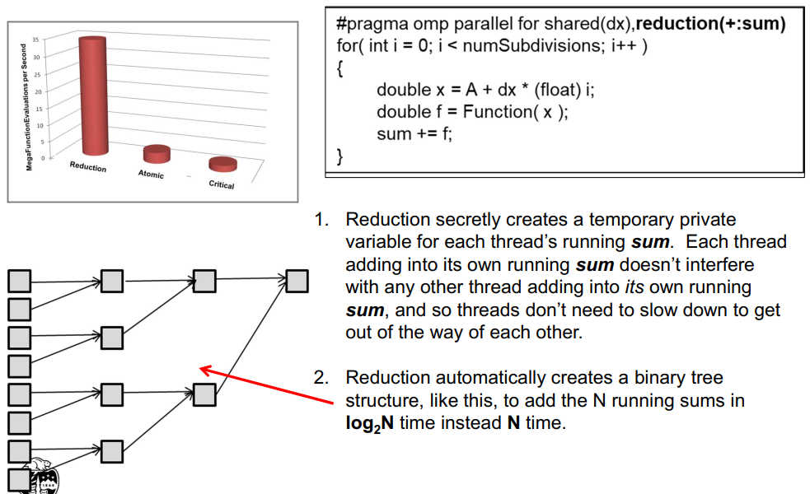
Read file trapezoid.1pp.pdf on Google Classroom Lab # 3 post.

Slide 20
Monte Carlo Estimation
Monte Carlo methods are a broad class of computational algorithms that rely on repeated random sampling to obtain numerical results. One of the basic examples of getting started with the Monte Carlo algorithm is the estimation of Pi.

Slide 21
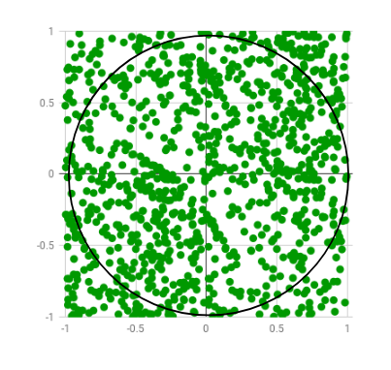
Estimation of Pi
The idea is to simulate random (x, y) points in a 2-D plane with domain as a square of side 2r units centered on (0,0). Imagine a circle inside the same domain with same radius r and inscribed into the square. We then calculate the ratio of number points that lied inside the circle and total number of generated points. Refer to the image below:

Slide 22
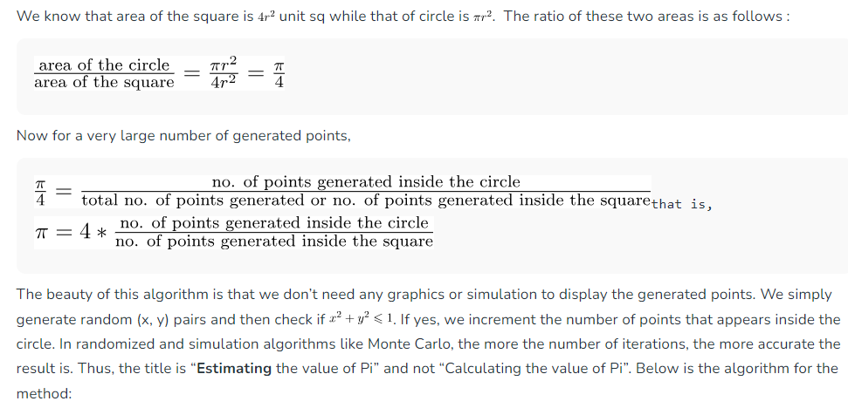

Slide 23
Estimation of Pi using Monte Carlo
1. Initialize circle_points, square_points and interval to 0. 2. Generate random point x. 3. Generate random point y. 4. Calculate d = x*x + y*y. 5. If d <= 1, increment circle_points. 6. Increment square_points. 7. Increment interval. 8. If increment < NO_OF_ITERATIONS, repeat from 2. 9. Calculate pi = 4*(circle_points/square_points). 10. Terminate. The code doesn’t wait for any input via stdin as the macro INTERVAL could be changed as per the required number of iterations. Number of iterations are the square of INTERVAL. Also, I’ve paused the screen for first 10 iterations with getch() and outputs are displayed for every iteration with format given below. You can change or delete them as per requirement.

Slide 24
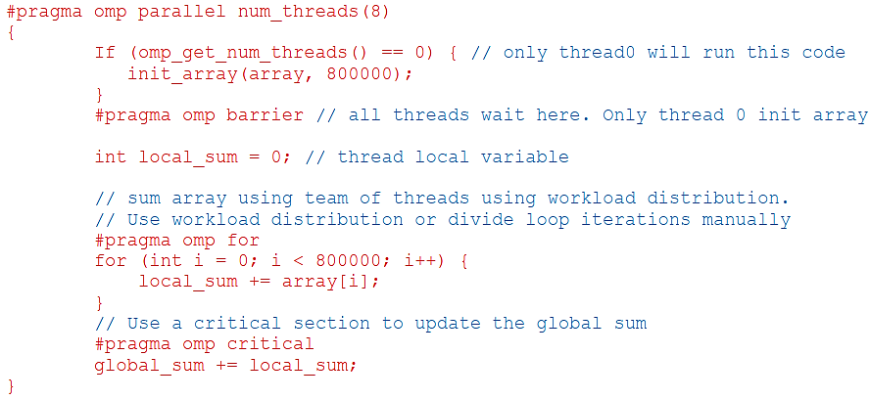
Practice – OpenMP Solution

